Slide 1




Welcome to Our Presentation
By: Team - 6

Slide 2


Presentation Topic
Bank Account Management System

Slide 3
Objective
Design: a functional console-based banking system to emulate common financial operations.
Utilize Object-Oriented Programming (OOP): principles for modular, reusable, and maintainable code.
Demonstrate file handling in Java for persistent data storage without databases.
Security: ,user-friendly interface for operations like account creation, login, balance checks, deposits, withdrawals, and transaction history.
Highlight OOP concepts like abstraction, polymorphism, inheritance, and encapsulation in a real-world application.

Slide 4

Bank Account Management System
A Console-Based Application
This application developed in Java programming Language
Use of Object-Oriented Programming (OOP) principles
It aims to emulate a basic banking system that facilitates common financial operations
It perform creating accounts, managing funds, and viewing transaction histories
This project will not use graphical interfaces or databases

Slide 5



Project Part
Account Creation
Authentication
Account Management
Create a account using name, phone number and password
Authenticate user using user phone or account number and password , Login & Logout
Managing Fund, Deposit, Withdraw, Balance inquiry, Show Transaction History

Slide 6

01
Account Number
02
Account Holder Name
Account
Creation
03
Password

Slide 7
0
1
Account Number
Authentication
2
Password
04

Slide 8
01
Balance Inquiry
02
Deposit Money
Account
Management
03
Withdraw Money
04
Transaction History

Slide 9
File Structure
Source Packages
bank.management.system
Abstract Class
Account.java
BankSystem.java
SavingsAccount.java
Main.java
Main Class

Slide 10
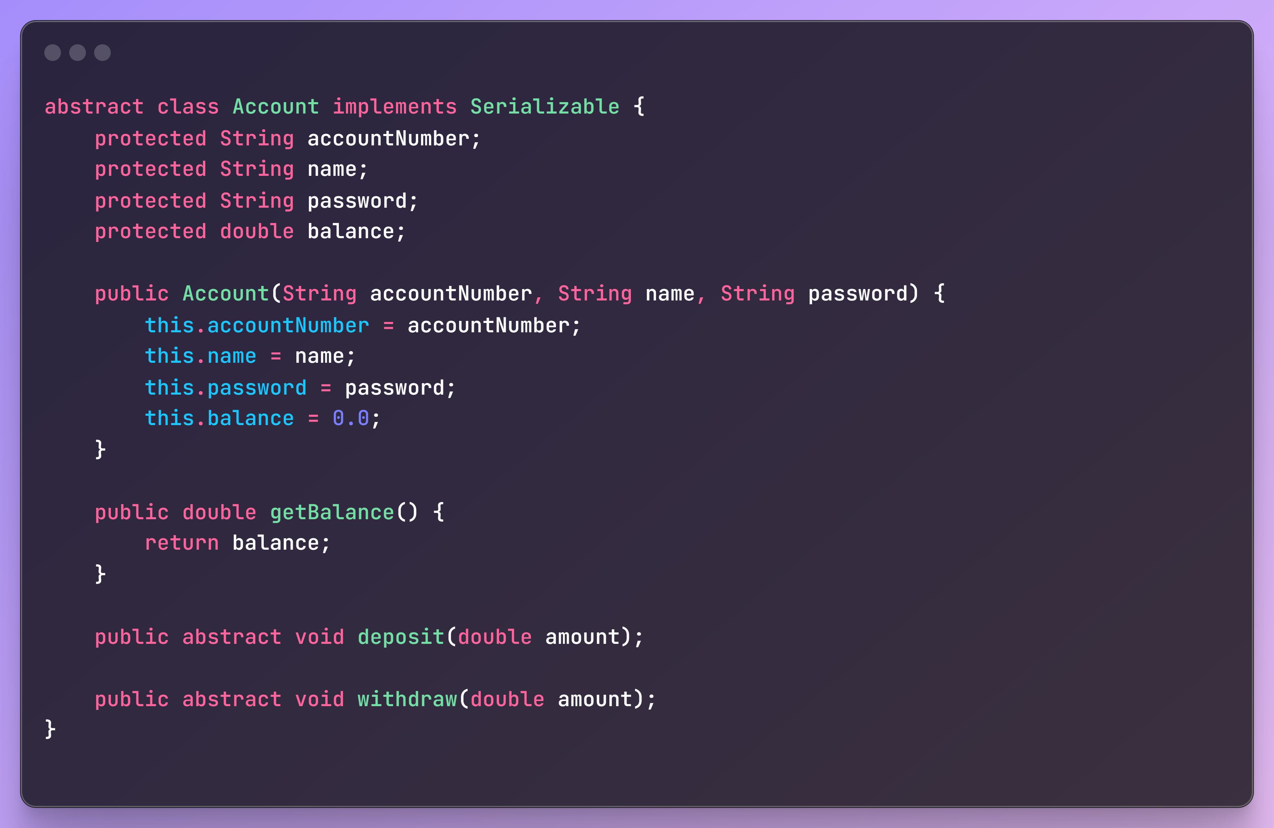
Account.java
Define Abstract Class
Access Modifier
Constructor
Abstract Method

Slide 11
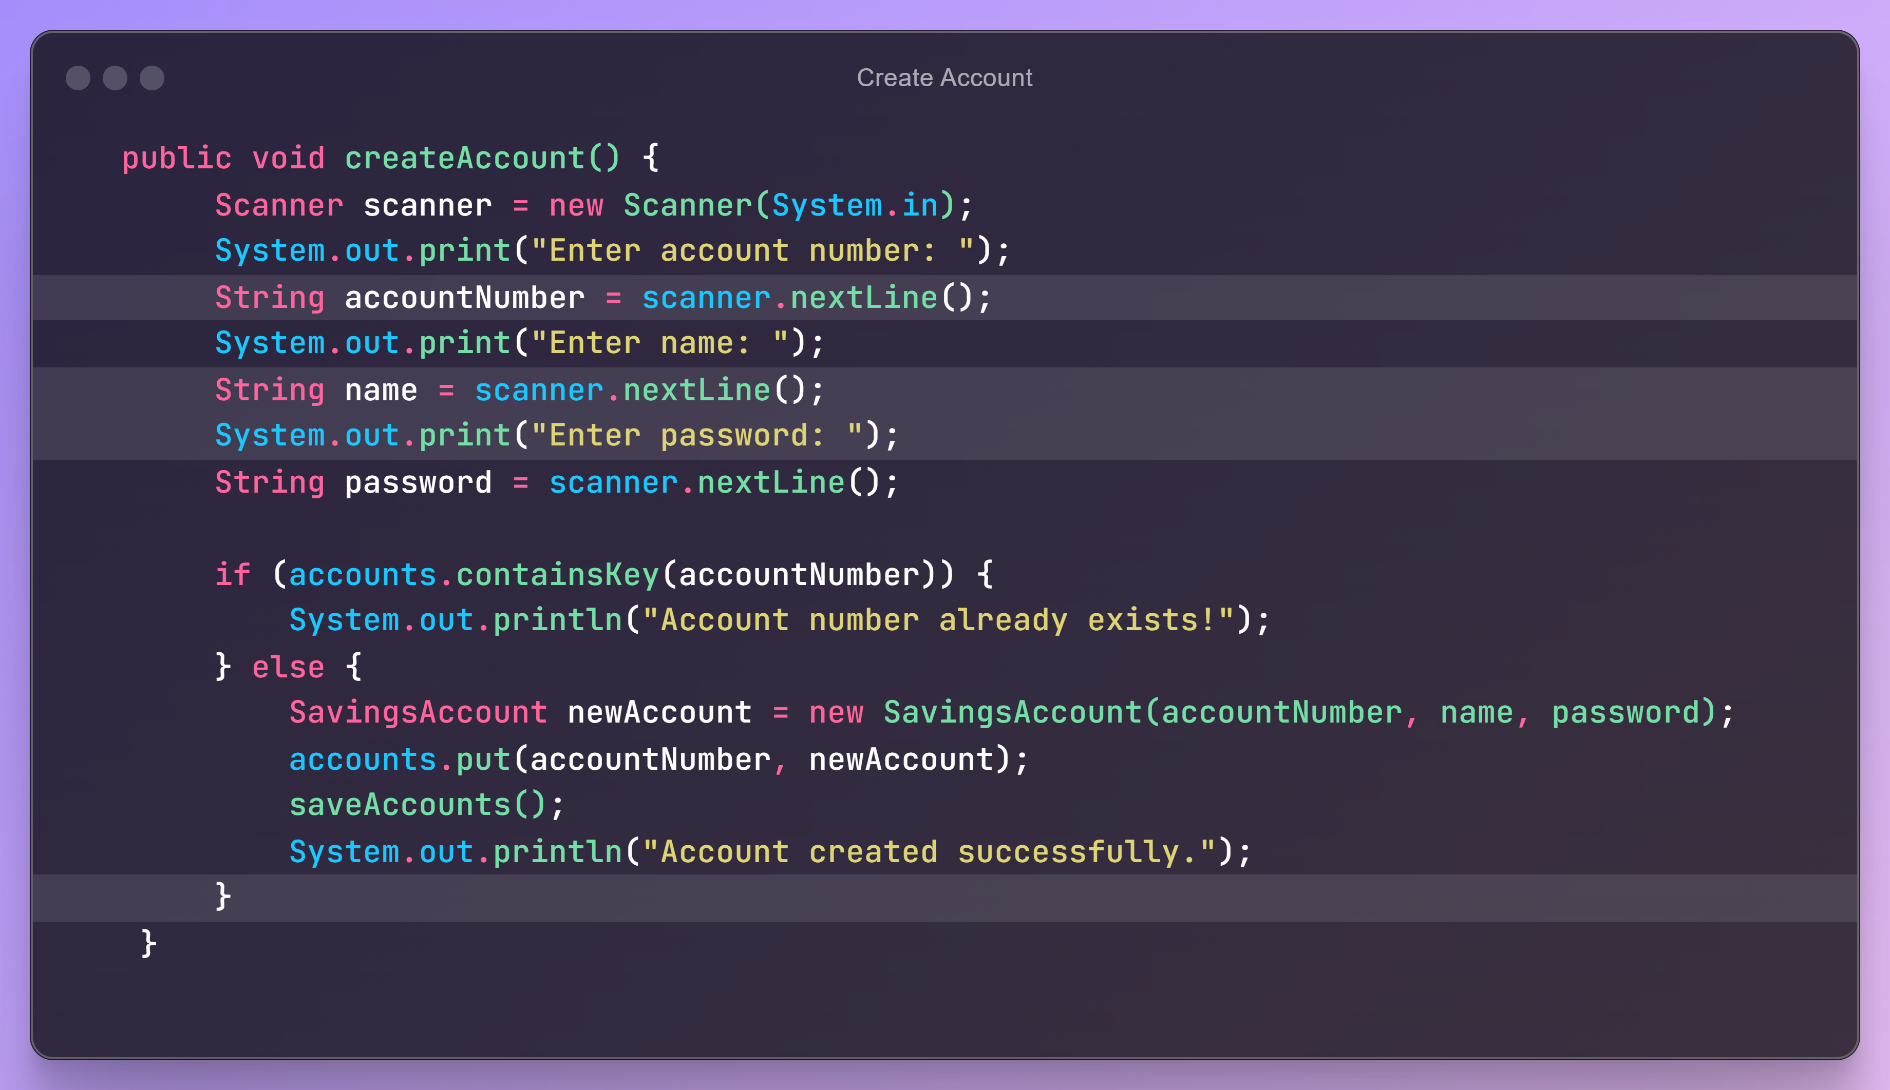
BankSystem.java
Take User Input
Store in Variable
Create a object

Slide 12
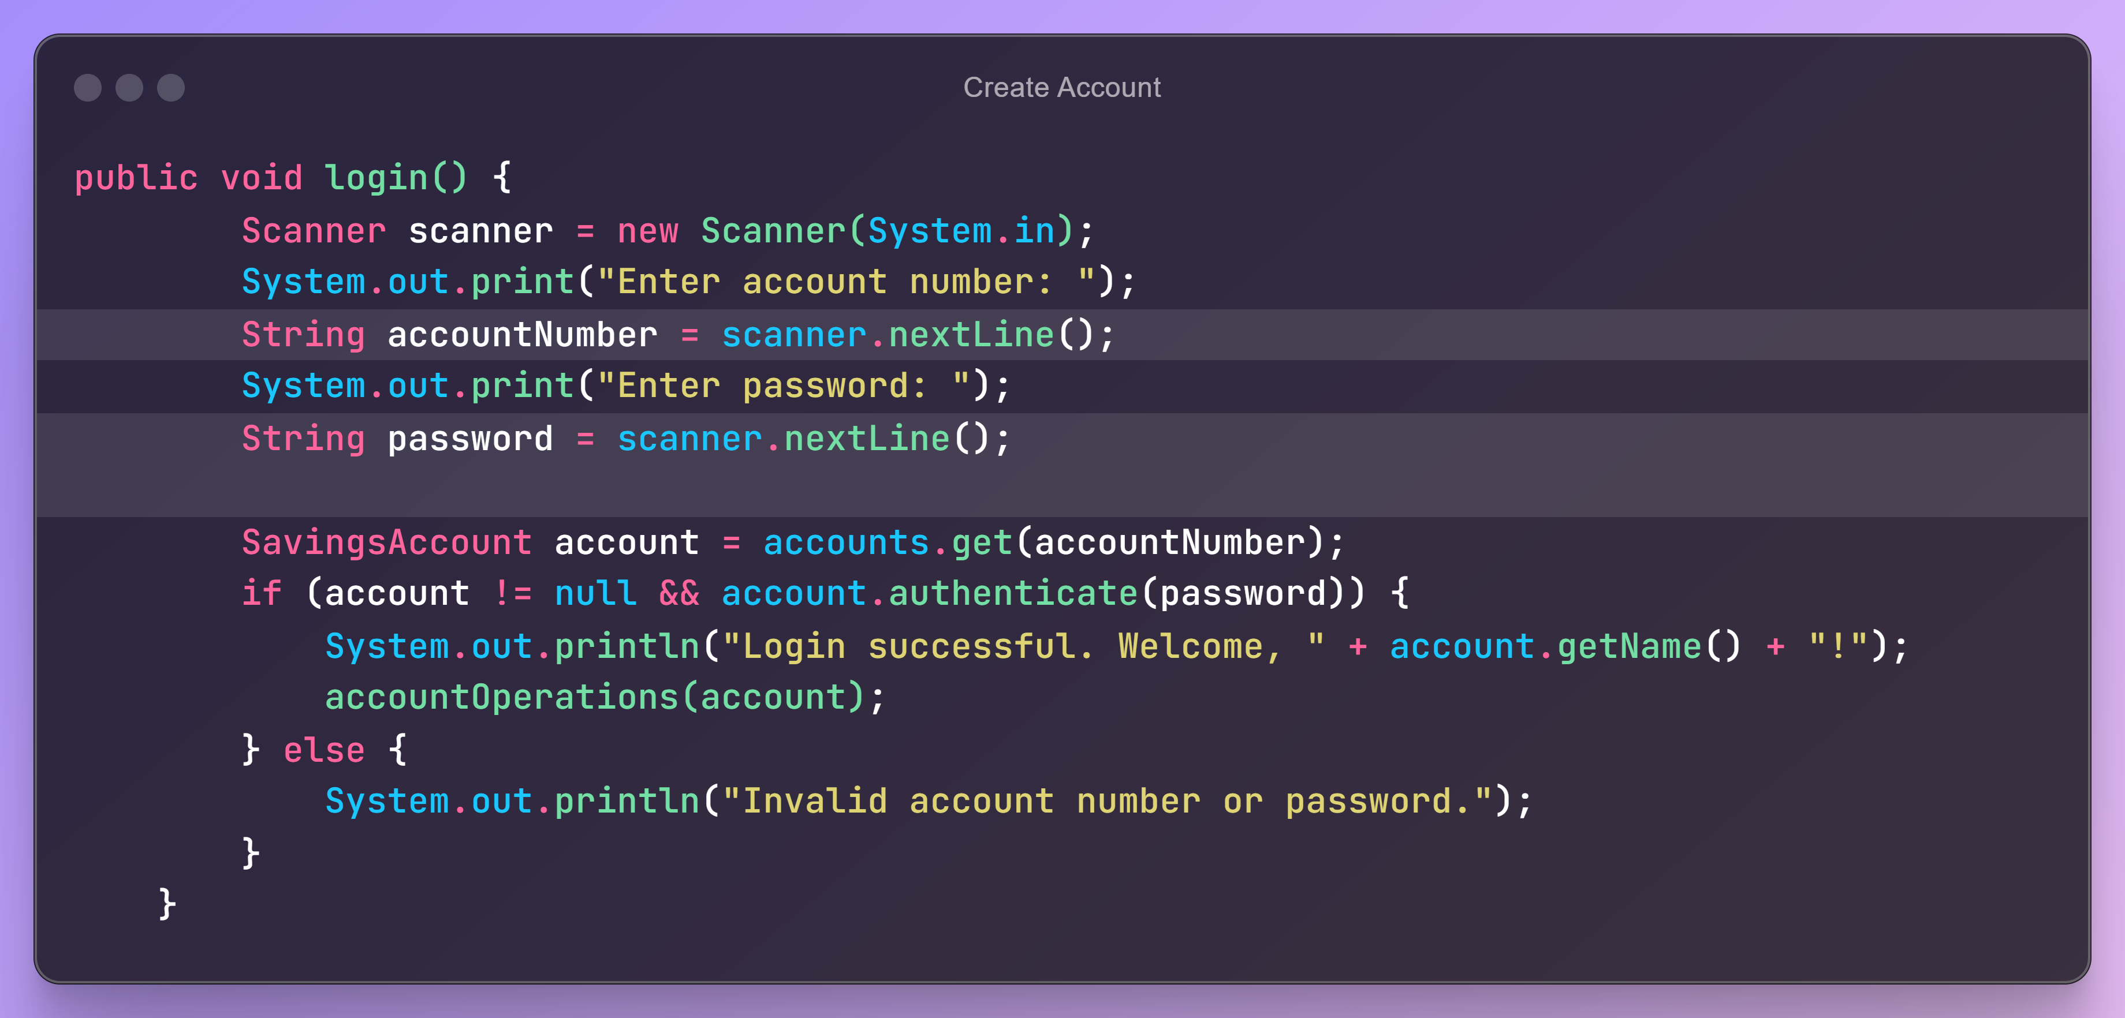
BankSystem.java
Take input of Account Number and Password
Authenticating User

Slide 13
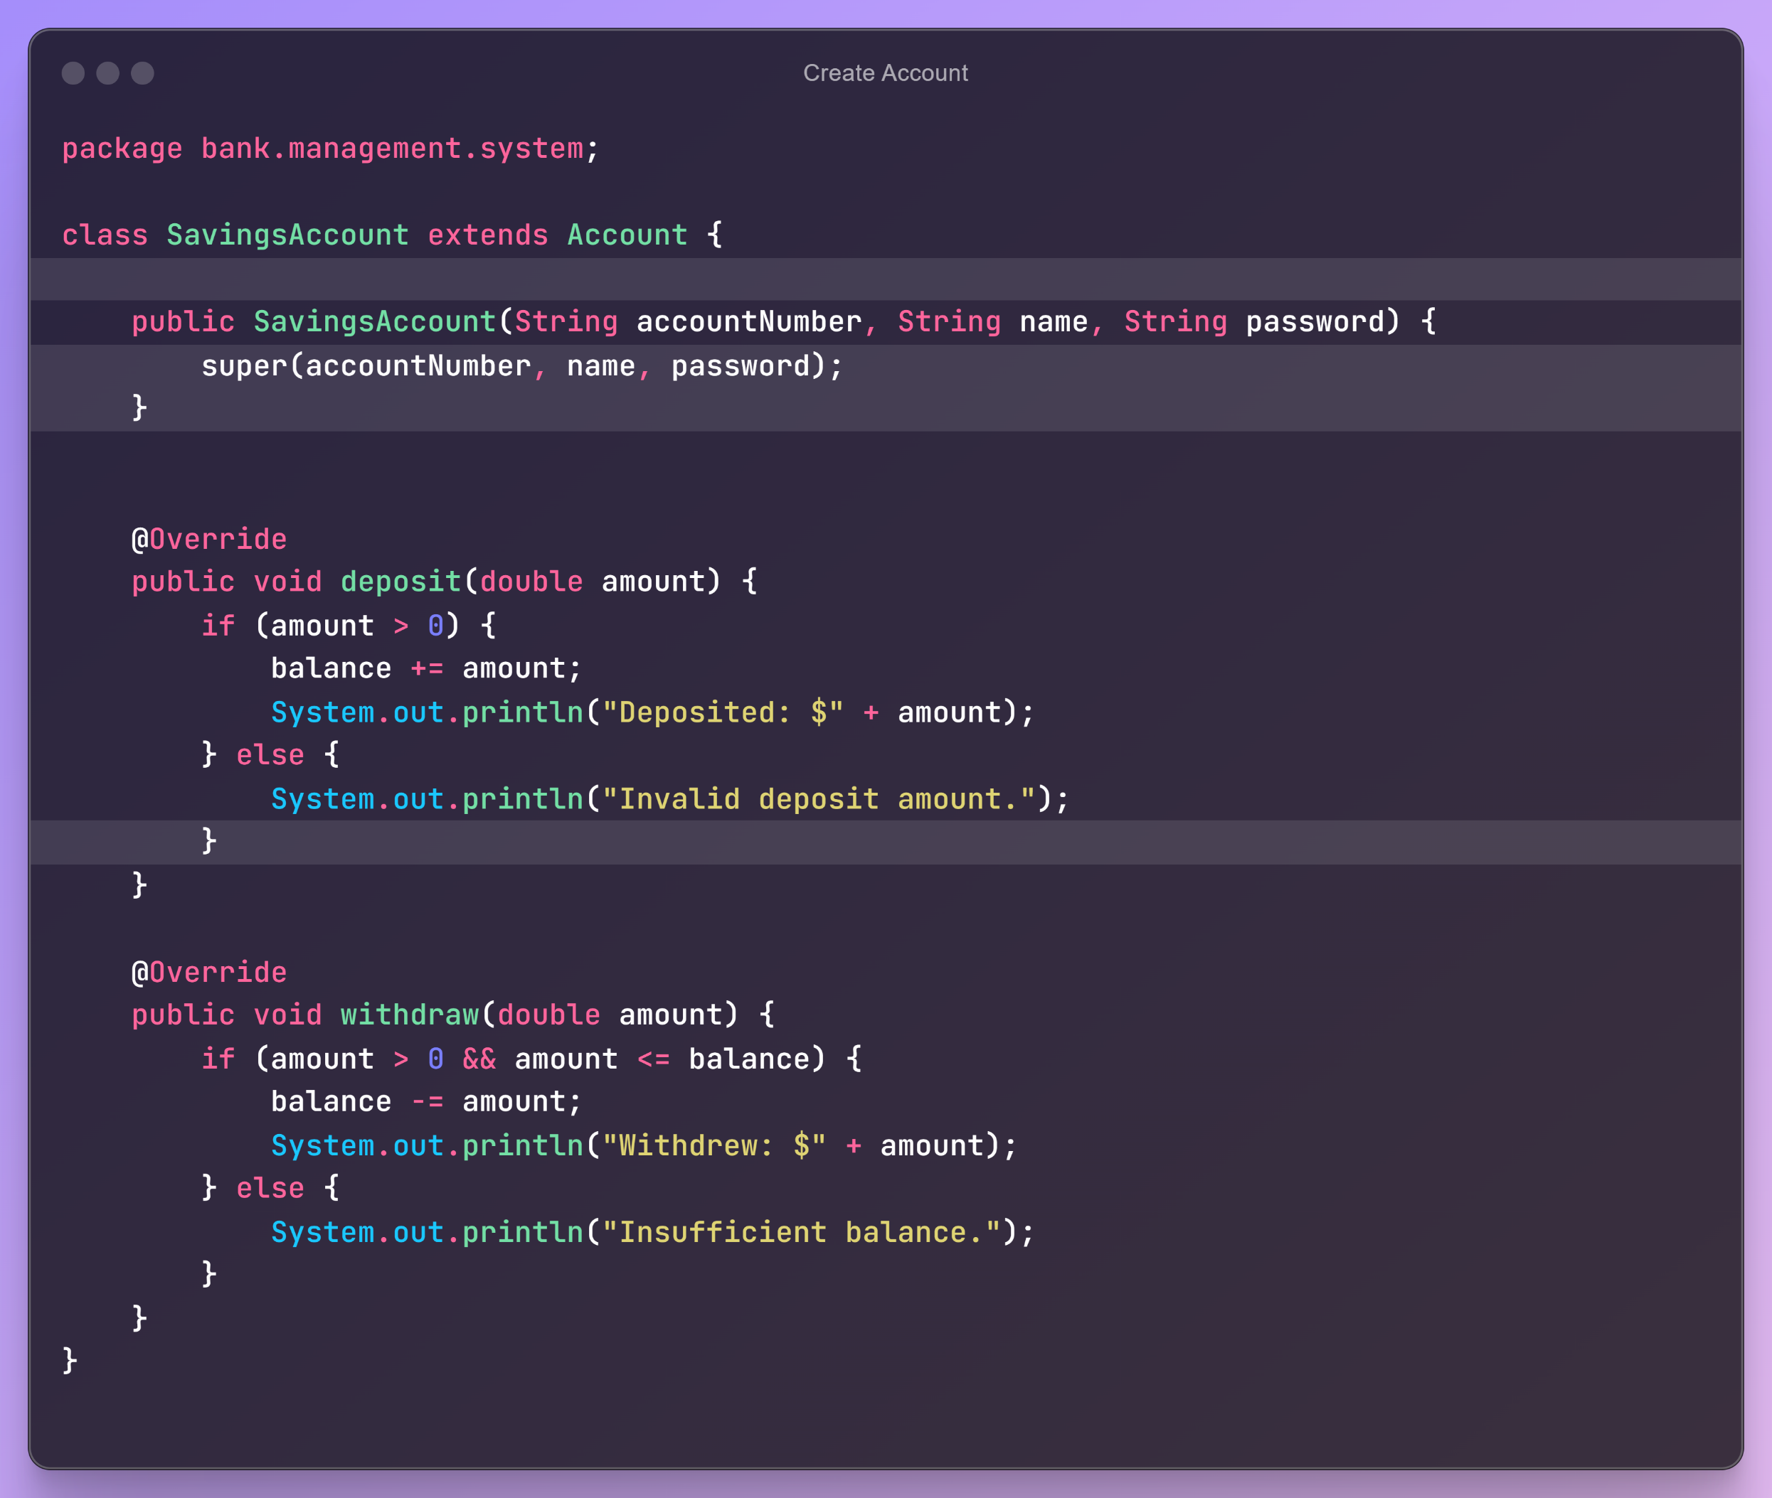
SavingsAccount.java
Inherit Abstract Class
Method Overriding
Implementing Logic

Slide 14
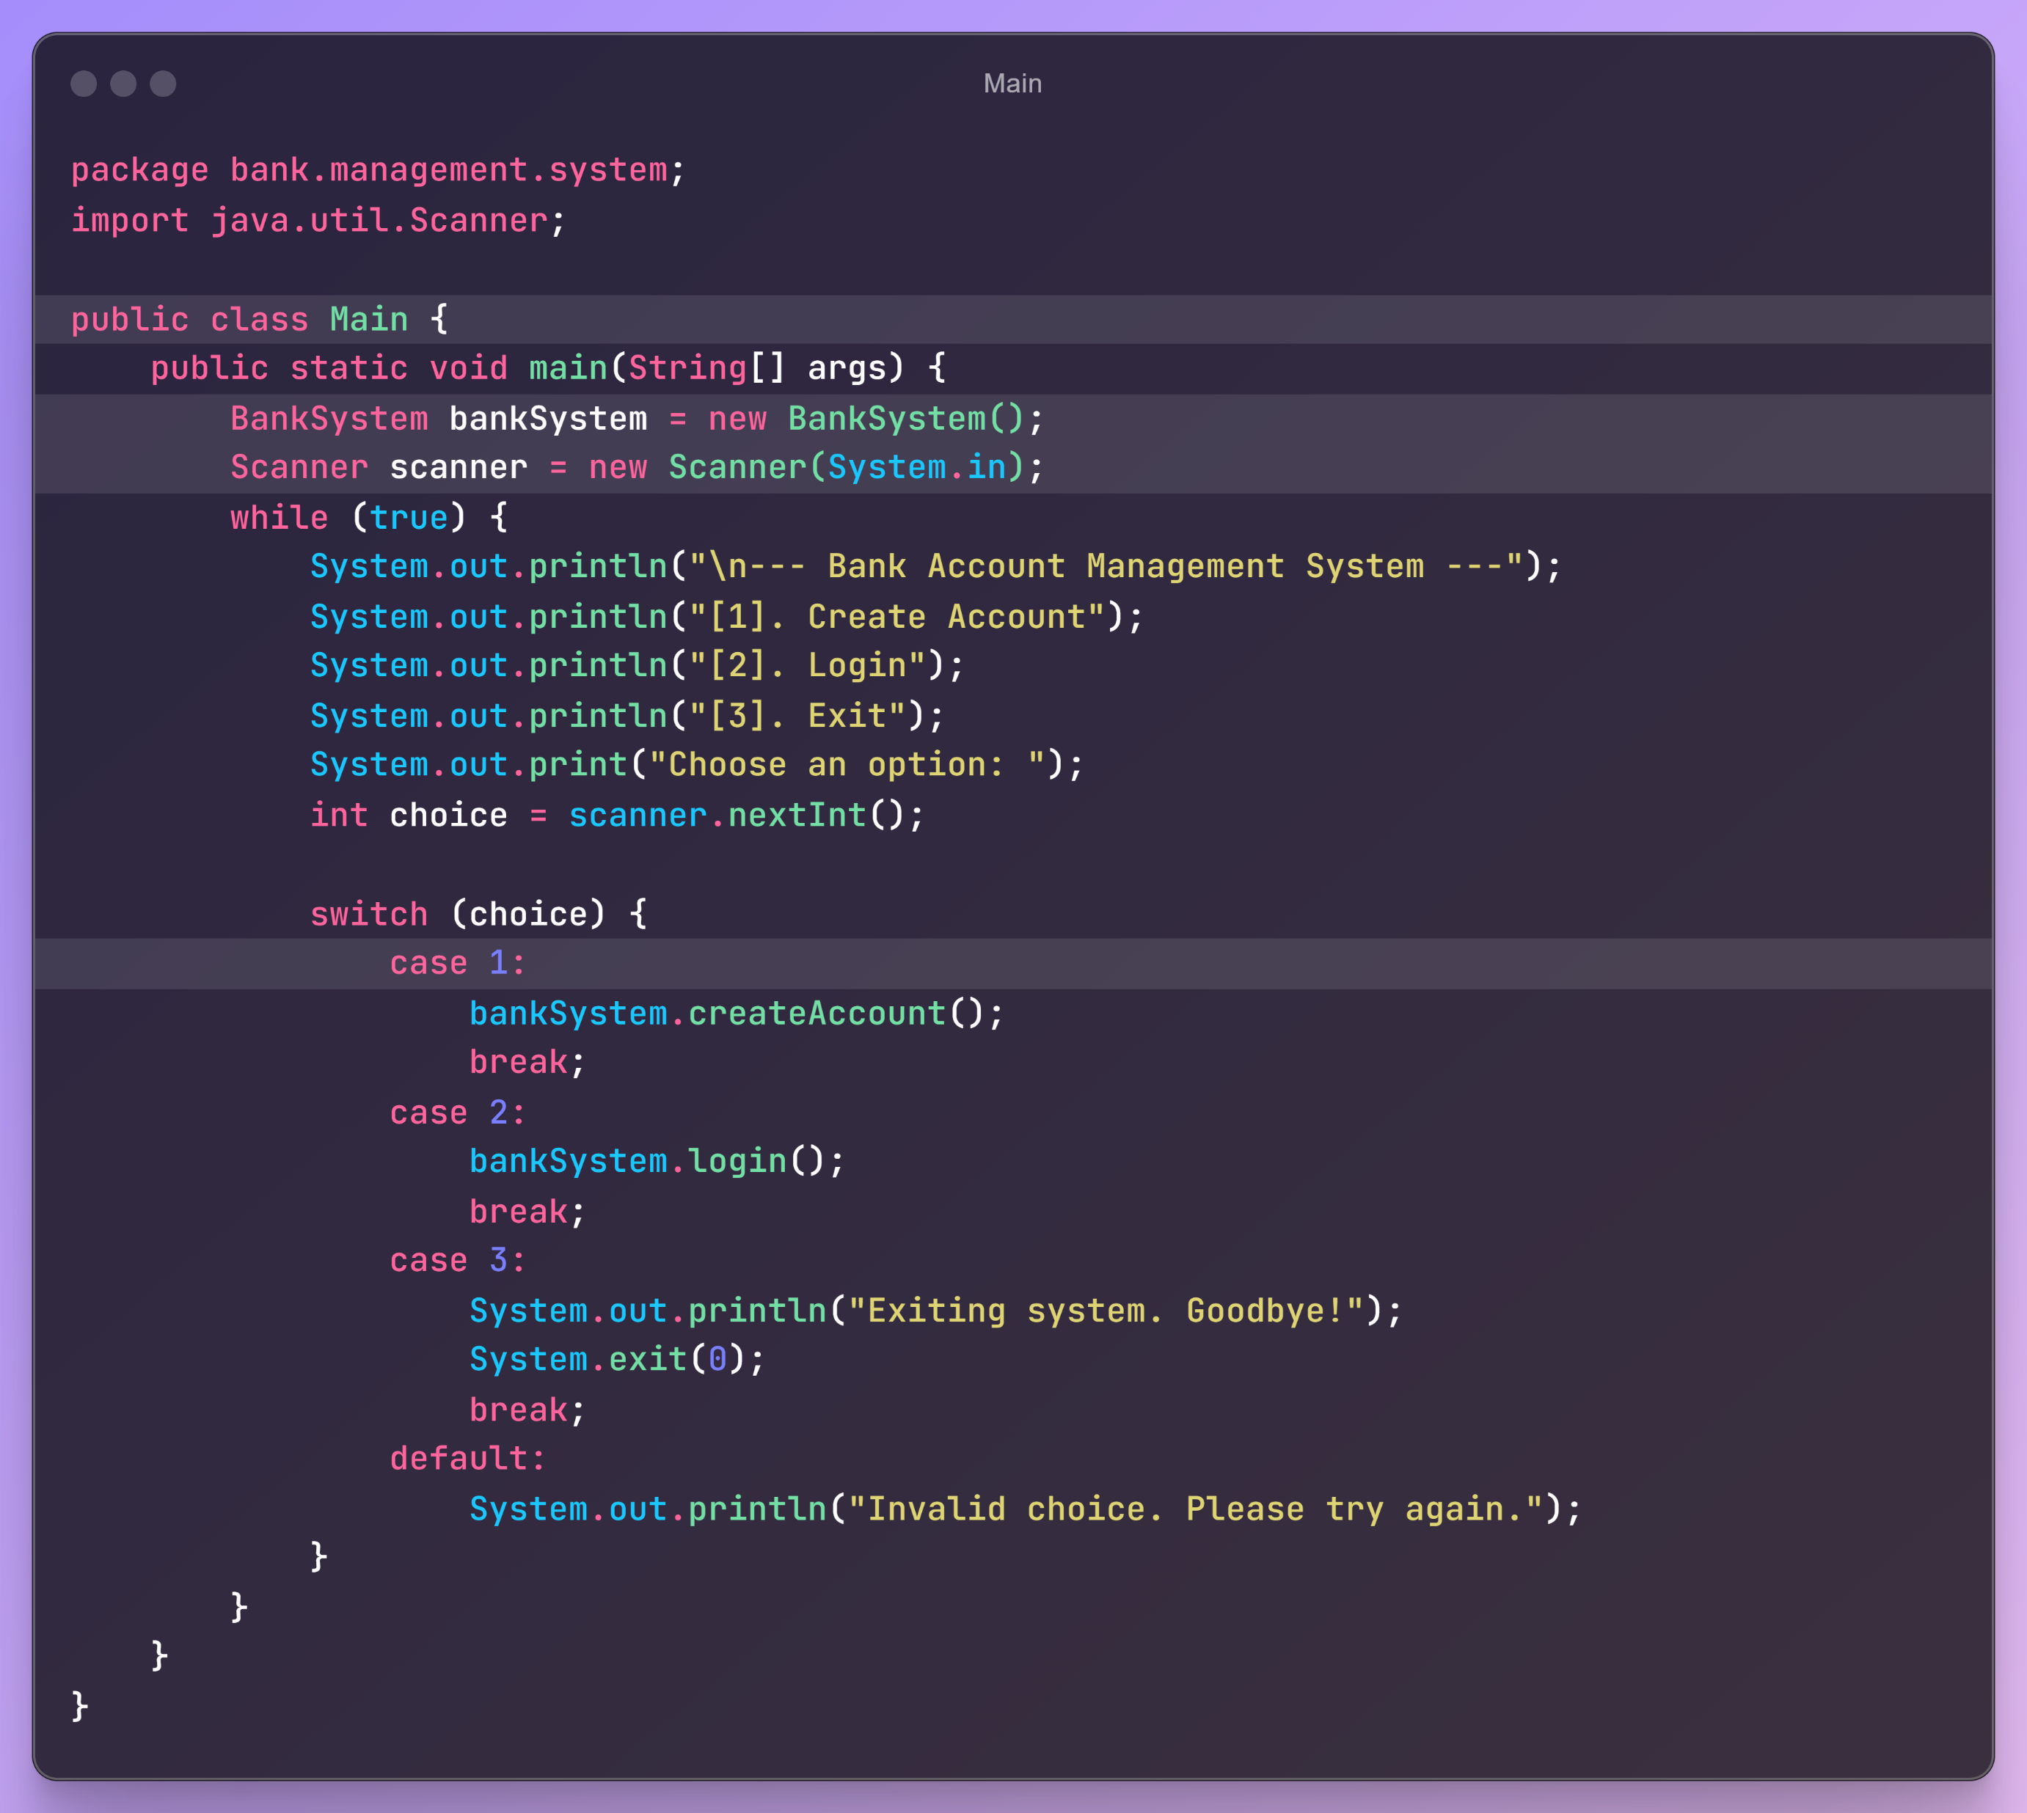
Main.java
Define Package
Import Build-in Package
Select Option until valid

Slide 15
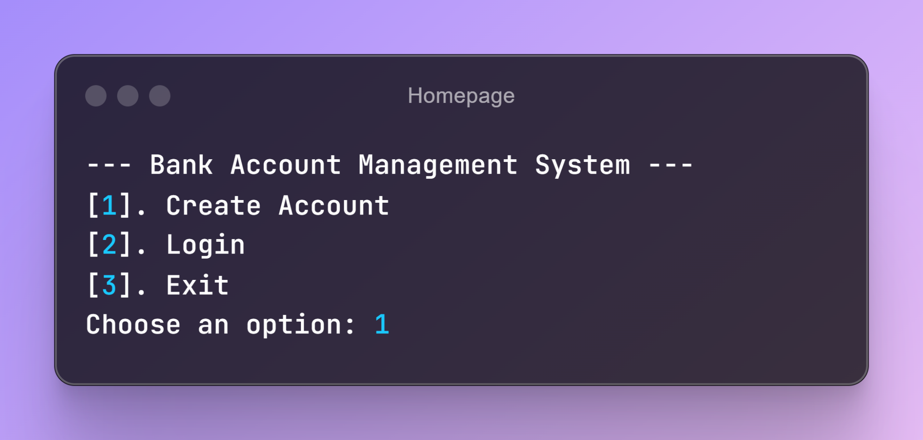
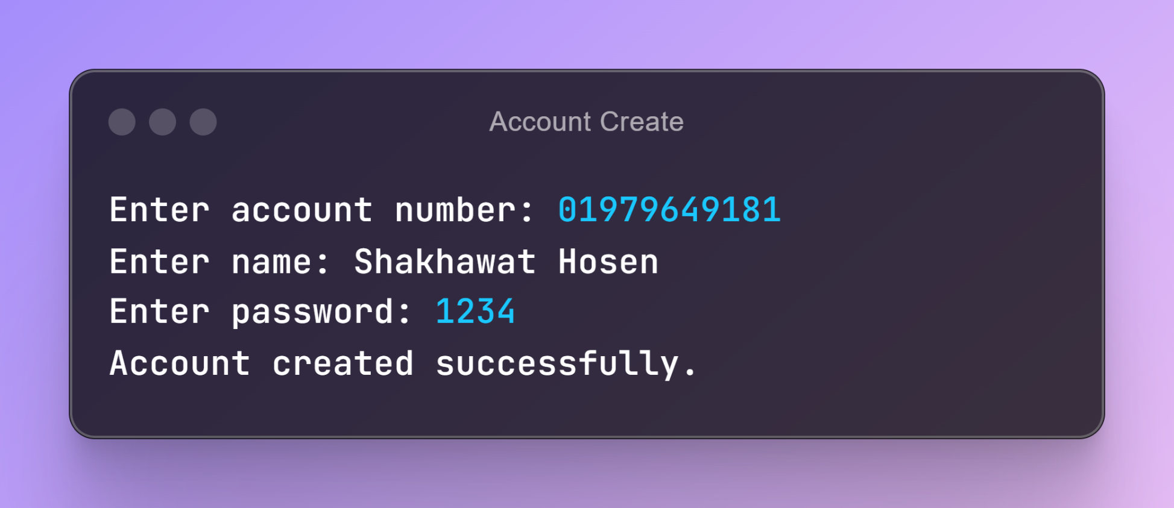
Output
1
2

Slide 16
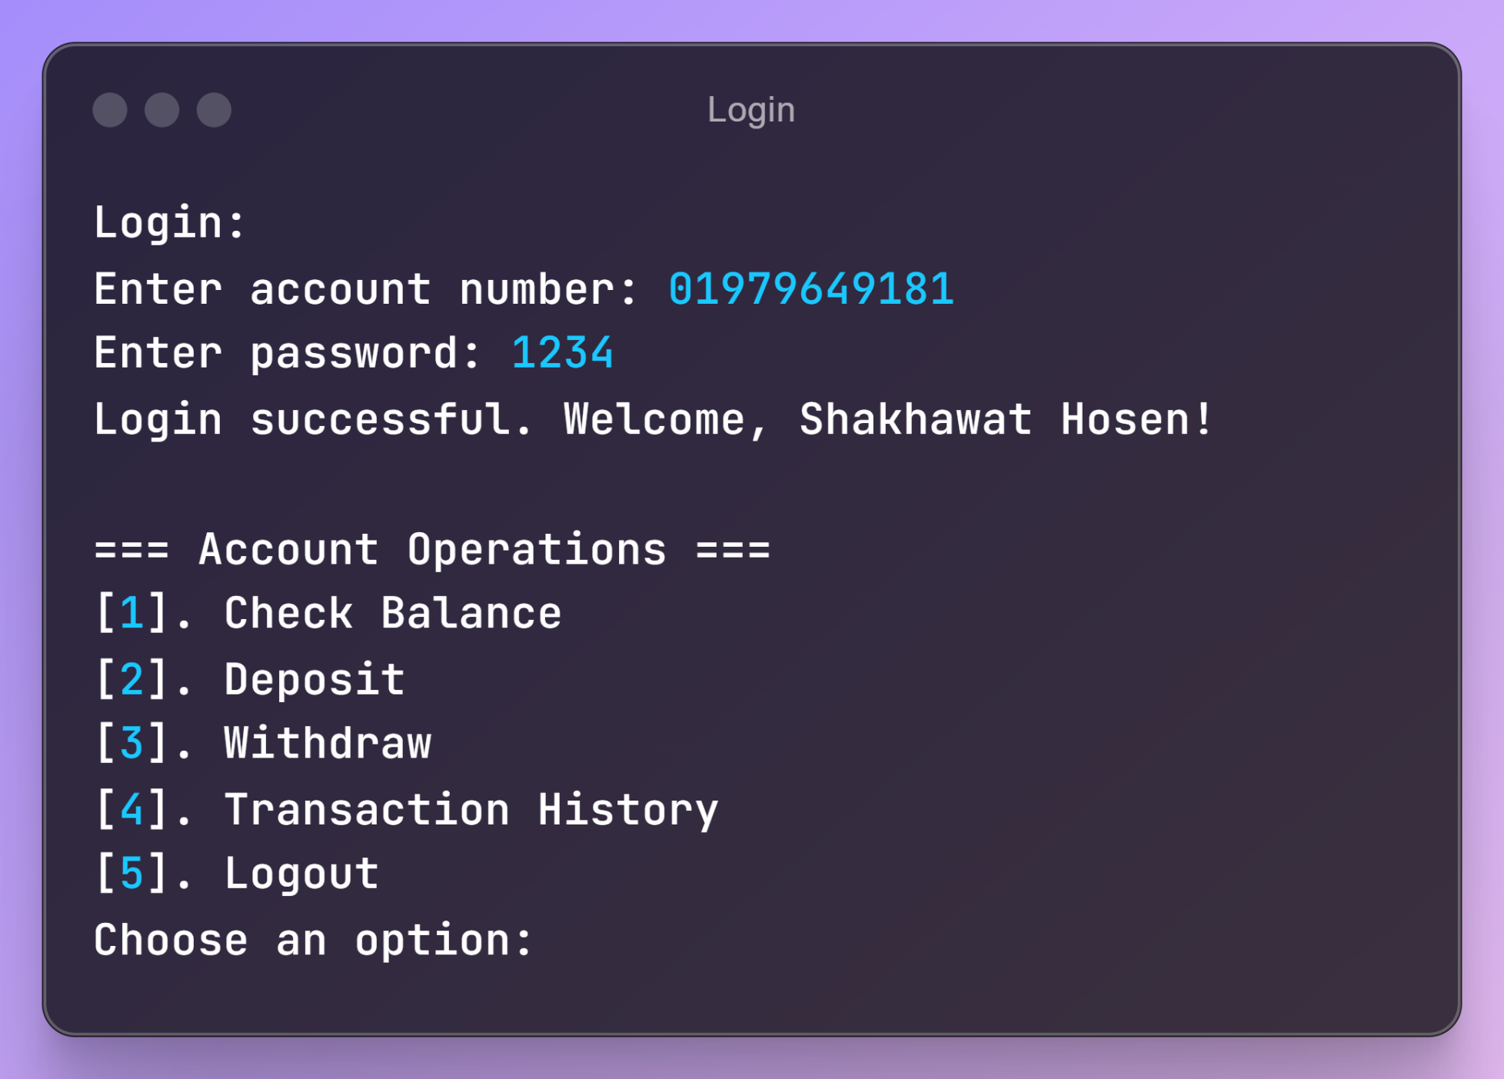
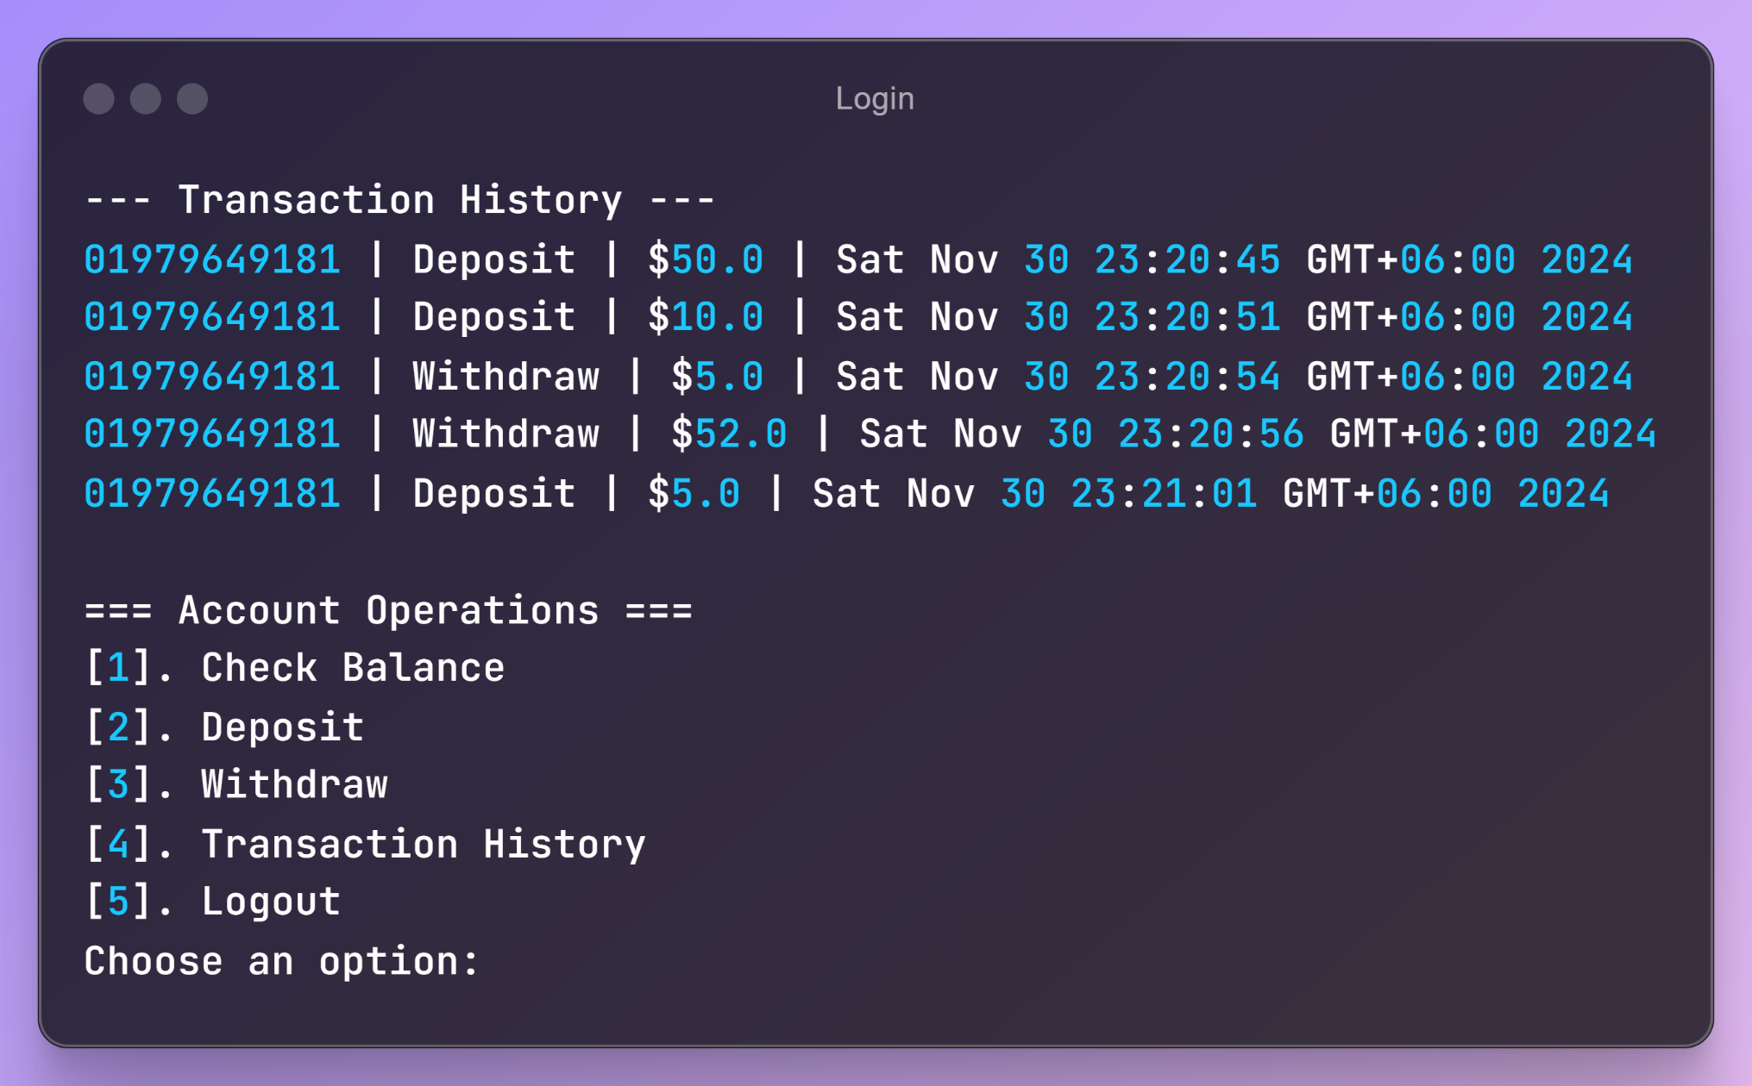
Output
3
4

Slide 17


Any Question?
About this project

Slide 18
Team - 6
Shakhawat Hosen – CR [Team Leader] - 34
Atiqur Rahman - 35
Mohammad Mahfuz Hasan Sourav - 32
Mahmudul Hasan Mridul - 33
Mahim Mahmud - 42
Jibon Islam Santo - 31

Slide 19



Write Once,
Run Anywhere!

